Slide 1

Design Thinking
“Failure is data, not defeat.” — David & Tom Kelley, Creative Confidence
How to build your creative confidence | David Kelley
What is creativity and why is it important to me?
Look at creativity curve, are you using your creative potential?
Can you really cultivate your creativity?
How do creativity and innovation relate?
Innovation story example
What are techniques to bring innovation to your job?

Slide 2
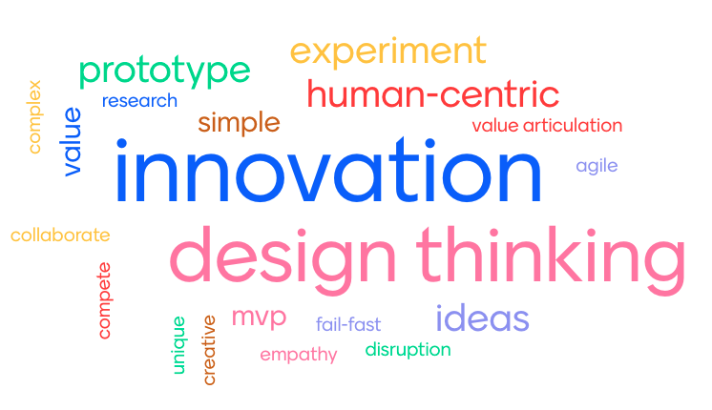
So Why is Creativity Important?

Slide 3

We Start our Education Here….

Slide 4

We End Up Here…

Slide 5
Did You Know…..
Age 12: Your creative output has declined to about 2% of your potential
Age 13+: This is it. Your creative output stays 2%
Age 5: You are using about 80% of your creative potential

Slide 6
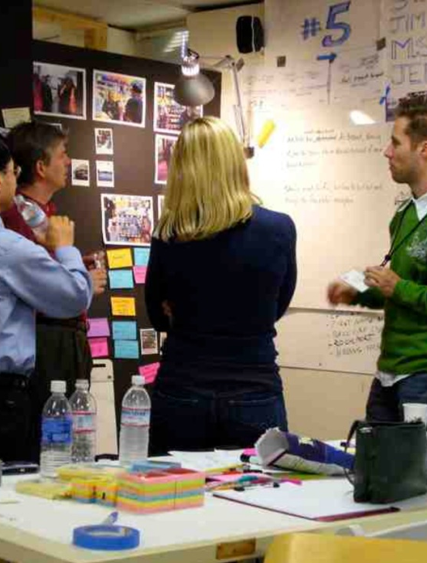


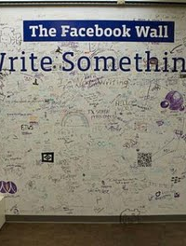
It Can Be Better…..

Slide 7

From the creative confidence framework, the knowing-doing gap is closed by shifting from analysis paralysis to a "do something" mindset. It is the combination of having big ideas and the belief and courage that you have the ability to act on them, learning through iterative experimentation rather than fearing failure.

Slide 8

Creativity – What It Is?

Slide 9

Creativity – What It Is
Creativity is a step further on from imagination, because it involves a lot more than just being imaginative.
It is: “the process of having original ideas that have value.” Being creative “involves doing something. It would be odd to describe someone as creative who never did anything. … Creativity involves putting your imagination to work. In a sense, creativity is applied imagination.”

Slide 10


Everyone has the power Everyone has the spark

Slide 11

Cultivate the creative spark:
Choose creativity. , decide to make it happen.
Think like a traveler with fresh eyes. Expose yourself to new ideas and experiences.
Engage in relaxed attention.
Empathize with your end user. Innovative ideas come when you better understand the needs and context of the people you are creating solutions for.
Do observations in the field.
Ask why questions.
Reframe questions, start from a different point of view.
Build a creative support network. Find collaborators and others to share ideas, suggestions, and criticism.

Slide 12
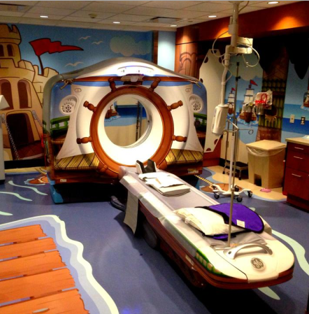
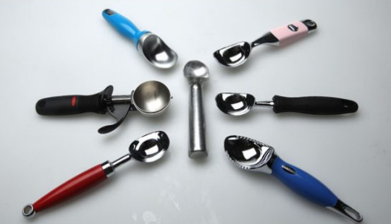

Creativity vs. Innovation
Creativity = Act of conceiving something original or unusual
Innovation = Implementing something new; Applying creative thinking

Slide 13

The Dyson Story …

Slide 14


If you were curious about the wheelbarrow

Slide 15
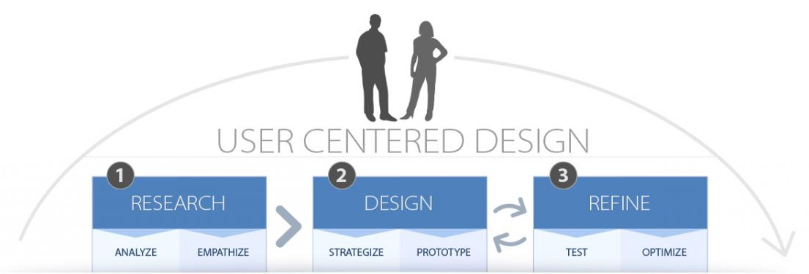
Innovation techniques: User Centered Design

Slide 16
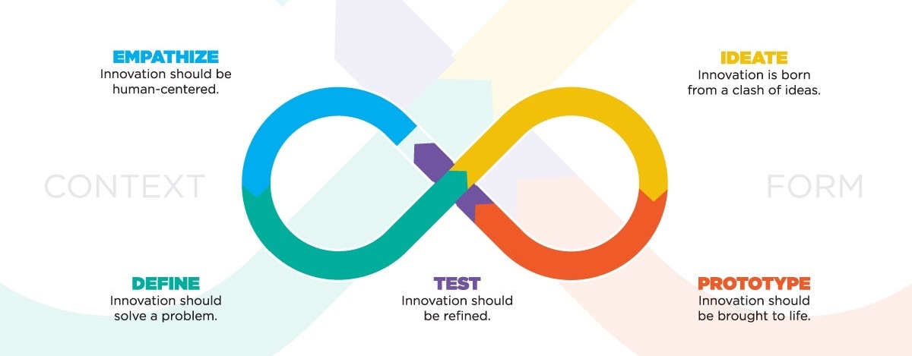
Innovation techniques: Design Thinking

Slide 17

Innovation techniques: Design Thinking
“Design thinking is a way of finding human needs and creating new solutions using the tools and mindsets of design practitioners.” “Being human-centered is at the core of our innovation process. Deep empathy for people makes our observations powerful sources of inspiration.” Design thinking is thus “a methodology … [it is] our process for creativity and innovation.”

Slide 18

Innovation techniques: Empathy
“Empathy means challenging your preconceived ideas and setting aside your sense of what you think is true in order to learn what is actually true.”

Slide 19


